Slide 1
Letter Wheel
Based on Cognitive Therapy weekly puzzle in Saturday Telegraph

Slide 2
480mm
I
E
J
F
L
H
K
G
Letter Wheel
250mm
These wheels are all in perfect, non-slip contact with their neighbours and are driven by the first wheel (with its direction of spin shown).
A
M
B
N
D
P
C
O
107mm
When the wheels finally come to rest which letter will be in this position?
The lengths refer to the diameter of each wheel.
(Diagram not to scale)
200mm
130mm
This wheel makes 69 complete revolutions in the direction shown

Slide 3


Letter Wheel
Consider the simplest scenario of just two wheels.
$$a$$
$$b$$

Slide 4

Letter Wheel
Consider the simplest scenario of just two wheels.
$$a$$
$$b$$
$$equal lengths$$

Slide 5




Letter Wheel
Consider the simplest scenario of just two wheels.
$$\frac{a}{b} rev.$$
$$a$$
$$1 rev.$$
$$b$$
$$πa=1 revolution$$
$$πa=\frac{πa}{πb}revolution=\frac{a}{b} revolution$$

Slide 6


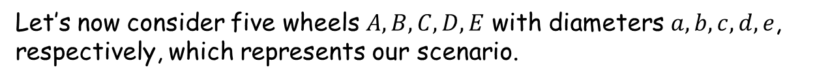



Letter Wheel
Let’s now consider five wheels $A, B, C, D, E$ with diameters $a, b, c, d, e$, respectively, which represents our scenario.
$$A$$
$$B$$
$$C$$
$$D$$
$$E$$
The first thing to note is that with five wheels (i.e. an odd number) the last wheel turns in the same direction as the first.

Slide 7


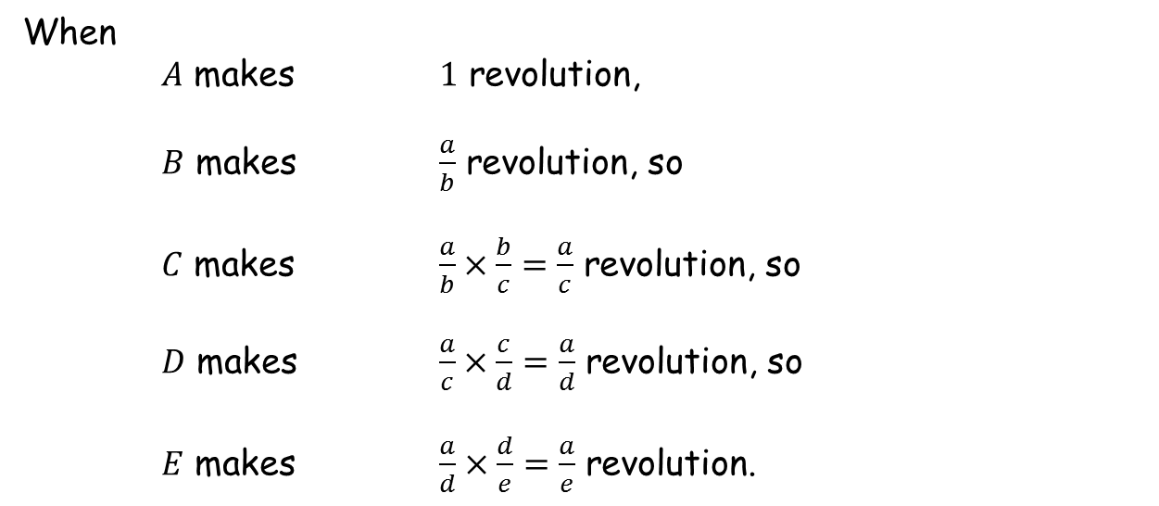




Letter Wheel
$$A$$
$$B$$
$$C$$
$$D$$
$$E$$
When
$A$ makes $1$ revolution,
$B$ makes $\frac{a}{b}$ revolution, so
$C$ makes $\frac{a}{b}×\frac{b}{c}=\frac{a}{c}$ revolution, so
$D$ makes $\frac{a}{c}×\frac{c}{d}=\frac{a}{d}$ revolution, so
$E$ makes $\frac{a}{d}×\frac{d}{e}=\frac{a}{e}$ revolution.
So as far as our puzzle is concerned the only relevant diameters are the first and last.
When the first wheel makes $1$ revolution the last one makes $\frac{130}{480}=\frac{13}{48}$ revolution.

Slide 8
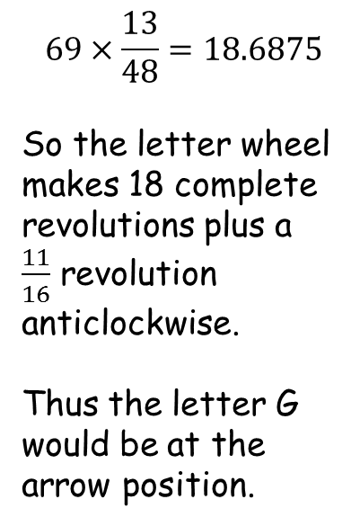
480mm
SIC_39
I
E
J
F
L
H
K
G
Letter Wheel
$$69×\frac{13}{48}=18.6875$$
So the letter wheel makes 18 complete revolutions plus a $\frac{11}{16}$ revolution anticlockwise.
Thus the letter G would be at the arrow position.
A
M
B
N
D
P
C
O
130mm
This wheel makes 69 complete revolutions in the direction shown

Slide 10
Note to Teacher -1
480mm
I
E
J
F
L
H
K
G
250mm
Answer is the 7th letter
of the alphabet - G
A
M
B
N
D
P
C
O
107mm
200mm
130mm

Slide 11
Note to Teacher -2
The diameters of the driving wheel and the letter wheel are the same for everyone. They are 130 mm and 480 mm, respectively.
This means that when the driving wheel makes 48 revolutions then the letter wheel will make 13 revolutions, exactly. They will both end up at their starting positions.
Press reset and set the number of revolutions to 48. Note the positions of the dots on each wheel, which should all be at 6 o’clock. After the 48 revolutions the letter wheel will be in its original position with the arrow pointing at “B” (the other smaller wheels will not, of course, be in their starting positions).
This shows that you can keep subtracting 48 from the number of revolutions until you get a number less than 48 to determine the fraction of a circle that the letter wheel rotates.

Slide 12
Note to Teacher -3
If you are conversant with Scratch you can show a few other things.
For example, changing the diameter of the 3rd wheel to be the same as the first (set dia3=130 in the scripts for the “reset” sprite button) and then dragging the wheel so that it touches its neighbours should be done so that the pupils think everything is connected, although it really isn’t. This shows that the two wheels will always have the same orientation – use the pause button.
Note that pressing the shift key whilst pressing start ( ) will put Scratch in “Turbo Mode”, which speeds everything up.

Slide 13
RESOURCES

Slide 14
480mm
SIC_39
I
E
J
F
L
H
K
G
Letter Wheel
250mm
These wheels are all in perfect, non-slip contact with their neighbours and are driven by the first wheel (with its direction of spin shown).
A
M
B
N
D
P
C
O
105mm
When the wheels finally come to rest which letter will be in this position?
The lengths refer to the diameter of each wheel.
(Diagram not to scale)
206mm
130mm
This wheel makes 195 complete revolutions in the direction shown

Slide 15
480mm
SIC_39
I
E
J
F
L
H
K
G
Letter Wheel
250mm
These wheels are all in perfect, non-slip contact with their neighbours and are driven by the first wheel (with its direction of spin shown).
A
M
B
N
D
P
C
O
108mm
When the wheels finally come to rest which letter will be in this position?
The lengths refer to the diameter of each wheel.
(Diagram not to scale)
209mm
130mm
This wheel makes 150 complete revolutions in the direction shown

Slide 16
480mm
SIC_39
I
E
J
F
L
H
K
G
Letter Wheel
249mm
These wheels are all in perfect, non-slip contact with their neighbours and are driven by the first wheel (with its direction of spin shown).
A
M
B
N
D
P
C
O
108mm
When the wheels finally come to rest which letter will be in this position?
The lengths refer to the diameter of each wheel.
(Diagram not to scale)
211mm
130mm
This wheel makes 198 complete revolutions in the direction shown

Slide 17
480mm
SIC_39
I
E
J
F
L
H
K
G
Letter Wheel
250mm
These wheels are all in perfect, non-slip contact with their neighbours and are driven by the first wheel (with its direction of spin shown).
A
M
B
N
D
P
C
O
111mm
When the wheels finally come to rest which letter will be in this position?
The lengths refer to the diameter of each wheel.
(Diagram not to scale)
209mm
130mm
This wheel makes 153 complete revolutions in the direction shown

Slide 18
480mm
SIC_39
I
E
J
F
L
H
K
G
Letter Wheel
253mm
These wheels are all in perfect, non-slip contact with their neighbours and are driven by the first wheel (with its direction of spin shown).
A
M
B
N
D
P
C
O
111mm
When the wheels finally come to rest which letter will be in this position?
The lengths refer to the diameter of each wheel.
(Diagram not to scale)
218mm
130mm
This wheel makes 201 complete revolutions in the direction shown

Slide 19
480mm
SIC_39
I
E
J
F
L
H
K
G
Letter Wheel
252mm
These wheels are all in perfect, non-slip contact with their neighbours and are driven by the first wheel (with its direction of spin shown).
A
M
B
N
D
P
C
O
114mm
When the wheels finally come to rest which letter will be in this position?
The lengths refer to the diameter of each wheel.
(Diagram not to scale)
219mm
130mm
This wheel makes 156 complete revolutions in the direction shown

Slide 20
480mm
SIC_39
I
E
J
F
L
H
K
G
Letter Wheel
262mm
These wheels are all in perfect, non-slip contact with their neighbours and are driven by the first wheel (with its direction of spin shown).
A
M
B
N
D
P
C
O
114mm
When the wheels finally come to rest which letter will be in this position?
The lengths refer to the diameter of each wheel.
(Diagram not to scale)
215mm
130mm
This wheel makes 204 complete revolutions in the direction shown

Slide 21
480mm
SIC_39
I
E
J
F
L
H
K
G
Letter Wheel
245mm
These wheels are all in perfect, non-slip contact with their neighbours and are driven by the first wheel (with its direction of spin shown).
A
M
B
N
D
P
C
O
101mm
When the wheels finally come to rest which letter will be in this position?
The lengths refer to the diameter of each wheel.
(Diagram not to scale)
209mm
130mm
This wheel makes 159 complete revolutions in the direction shown

Slide 22
480mm
SIC_39
I
E
J
F
L
H
K
G
Letter Wheel
245mm
These wheels are all in perfect, non-slip contact with their neighbours and are driven by the first wheel (with its direction of spin shown).
A
M
B
N
D
P
C
O
101mm
When the wheels finally come to rest which letter will be in this position?
The lengths refer to the diameter of each wheel.
(Diagram not to scale)
207mm
130mm
This wheel makes 111 complete revolutions in the direction shown

Slide 23
480mm
SIC_39
I
E
J
F
L
H
K
G
Letter Wheel
250mm
These wheels are all in perfect, non-slip contact with their neighbours and are driven by the first wheel (with its direction of spin shown).
A
M
B
N
D
P
C
O
104mm
When the wheels finally come to rest which letter will be in this position?
The lengths refer to the diameter of each wheel.
(Diagram not to scale)
213mm
130mm
This wheel makes 210 complete revolutions in the direction shown

Slide 24
480mm
SIC_39
I
E
J
F
L
H
K
G
Letter Wheel
261mm
These wheels are all in perfect, non-slip contact with their neighbours and are driven by the first wheel (with its direction of spin shown).
A
M
B
N
D
P
C
O
107mm
When the wheels finally come to rest which letter will be in this position?
The lengths refer to the diameter of each wheel.
(Diagram not to scale)
215mm
130mm
This wheel makes 165 complete revolutions in the direction shown

Slide 25
480mm
SIC_39
I
E
J
F
L
H
K
G
Letter Wheel
243mm
These wheels are all in perfect, non-slip contact with their neighbours and are driven by the first wheel (with its direction of spin shown).
A
M
B
N
D
P
C
O
110mm
When the wheels finally come to rest which letter will be in this position?
The lengths refer to the diameter of each wheel.
(Diagram not to scale)
224mm
130mm
This wheel makes 168 complete revolutions in the direction shown

Slide 26
480mm
SIC_39
I
E
J
F
L
H
K
G
Letter Wheel
253mm
These wheels are all in perfect, non-slip contact with their neighbours and are driven by the first wheel (with its direction of spin shown).
A
M
B
N
D
P
C
O
110mm
When the wheels finally come to rest which letter will be in this position?
The lengths refer to the diameter of each wheel.
(Diagram not to scale)
234mm
130mm
This wheel makes 120 complete revolutions in the direction shown

Slide 27
480mm
SIC_39
I
E
J
F
L
H
K
G
Letter Wheel
259mm
These wheels are all in perfect, non-slip contact with their neighbours and are driven by the first wheel (with its direction of spin shown).
A
M
B
N
D
P
C
O
113mm
When the wheels finally come to rest which letter will be in this position?
The lengths refer to the diameter of each wheel.
(Diagram not to scale)
211mm
130mm
This wheel makes 123 complete revolutions in the direction shown

Slide 28
480mm
SIC_39
I
E
J
F
L
H
K
G
Letter Wheel
263mm
These wheels are all in perfect, non-slip contact with their neighbours and are driven by the first wheel (with its direction of spin shown).
A
M
B
N
D
P
C
O
116mm
When the wheels finally come to rest which letter will be in this position?
The lengths refer to the diameter of each wheel.
(Diagram not to scale)
209mm
130mm
This wheel makes 174 complete revolutions in the direction shown

Slide 29
480mm
SIC_39
I
E
J
F
L
H
K
G
Letter Wheel
239mm
These wheels are all in perfect, non-slip contact with their neighbours and are driven by the first wheel (with its direction of spin shown).
A
M
B
N
D
P
C
O
103mm
When the wheels finally come to rest which letter will be in this position?
The lengths refer to the diameter of each wheel.
(Diagram not to scale)
219mm
130mm
This wheel makes 177 complete revolutions in the direction shown

Slide 30
480mm
SIC_39
I
E
J
F
L
H
K
G
Letter Wheel
245mm
These wheels are all in perfect, non-slip contact with their neighbours and are driven by the first wheel (with its direction of spin shown).
A
M
B
N
D
P
C
O
103mm
When the wheels finally come to rest which letter will be in this position?
The lengths refer to the diameter of each wheel.
(Diagram not to scale)
231mm
130mm
This wheel makes 225 complete revolutions in the direction shown

Slide 31
480mm
SIC_39
I
E
J
F
L
H
K
G
Letter Wheel
247mm
These wheels are all in perfect, non-slip contact with their neighbours and are driven by the first wheel (with its direction of spin shown).
A
M
B
N
D
P
C
O
106mm
When the wheels finally come to rest which letter will be in this position?
The lengths refer to the diameter of each wheel.
(Diagram not to scale)
229mm
130mm
This wheel makes 276 complete revolutions in the direction shown

Slide 32
480mm
SIC_39
I
E
J
F
L
H
K
G
Letter Wheel
257mm
These wheels are all in perfect, non-slip contact with their neighbours and are driven by the first wheel (with its direction of spin shown).
A
M
B
N
D
P
C
O
106mm
When the wheels finally come to rest which letter will be in this position?
The lengths refer to the diameter of each wheel.
(Diagram not to scale)
225mm
130mm
This wheel makes 324 complete revolutions in the direction shown

Slide 33
480mm
SIC_39
I
E
J
F
L
H
K
G
Letter Wheel
250mm
These wheels are all in perfect, non-slip contact with their neighbours and are driven by the first wheel (with its direction of spin shown).
A
M
B
N
D
P
C
O
109mm
When the wheels finally come to rest which letter will be in this position?
The lengths refer to the diameter of each wheel.
(Diagram not to scale)
211mm
130mm
This wheel makes 231 complete revolutions in the direction shown

Slide 34
480mm
SIC_39
I
E
J
F
L
H
K
G
Letter Wheel
251mm
These wheels are all in perfect, non-slip contact with their neighbours and are driven by the first wheel (with its direction of spin shown).
A
M
B
N
D
P
C
O
112mm
When the wheels finally come to rest which letter will be in this position?
The lengths refer to the diameter of each wheel.
(Diagram not to scale)
201mm
130mm
This wheel makes 234 complete revolutions in the direction shown

Slide 35
480mm
SIC_39
I
E
J
F
L
H
K
G
Letter Wheel
261mm
These wheels are all in perfect, non-slip contact with their neighbours and are driven by the first wheel (with its direction of spin shown).
A
M
B
N
D
P
C
O
112mm
When the wheels finally come to rest which letter will be in this position?
The lengths refer to the diameter of each wheel.
(Diagram not to scale)
211mm
130mm
This wheel makes 282 complete revolutions in the direction shown

Slide 36
480mm
SIC_39
I
E
J
F
L
H
K
G
Letter Wheel
253mm
These wheels are all in perfect, non-slip contact with their neighbours and are driven by the first wheel (with its direction of spin shown).
A
M
B
N
D
P
C
O
115mm
When the wheels finally come to rest which letter will be in this position?
The lengths refer to the diameter of each wheel.
(Diagram not to scale)
209mm
130mm
This wheel makes 237 complete revolutions in the direction shown

Slide 37
480mm
SIC_39
I
E
J
F
L
H
K
G
Letter Wheel
256mm
These wheels are all in perfect, non-slip contact with their neighbours and are driven by the first wheel (with its direction of spin shown).
A
M
B
N
D
P
C
O
115mm
When the wheels finally come to rest which letter will be in this position?
The lengths refer to the diameter of each wheel.
(Diagram not to scale)
239mm
130mm
This wheel makes 285 complete revolutions in the direction shown

